Slide 1
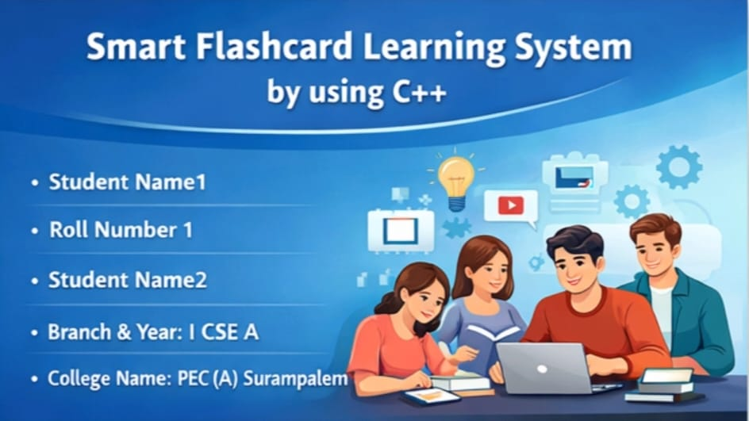
Smart Flashcard Learning System using C++
Student Name: ______
Roll No: ______
Branch: I Year CSE
College: PEC (A), Surampalem
PRESENTED BY:
Y.SRAVANTHI(25A31A05CO)
R.HARSHINI(25A31A05CH)
K.KEERTHIKA(25A31A05BQ)
N.DINESH(25A31A05DG)

Slide 2
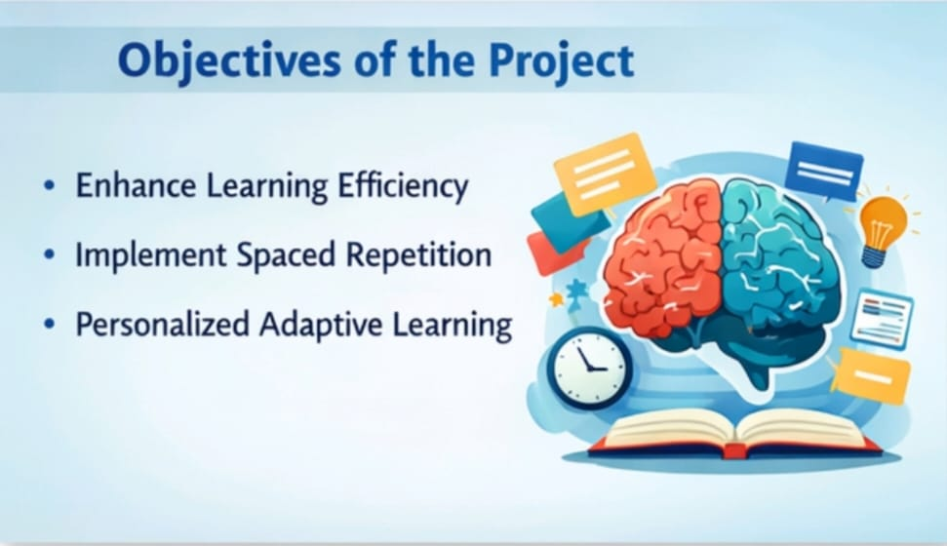
Objective of the Project
Improve memory using active recall
Implement spaced repetition
Reduce study time
Improve exam performance
Provide smart learning system

Slide 3
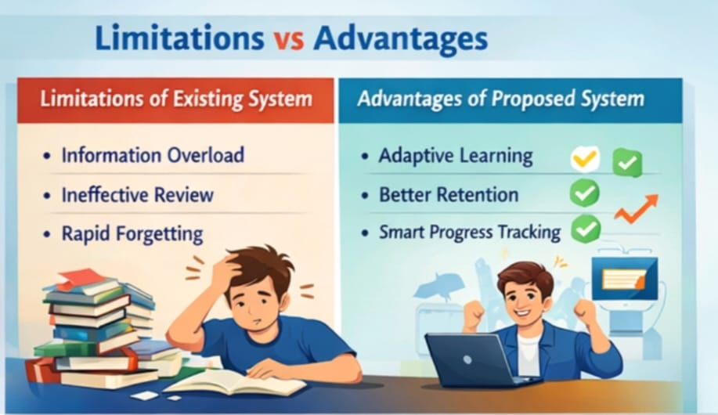
Problem Statement
Existing System (Disadvantages):
No progress tracking
No smart revision strategy
Difficult for large content
Proposed System (Advantages):
Smart revision system
Tracks performance
Easy storage & access
Efficient learning

Slide 4

Conclusion & Thank You
Modern learning solution
Improves retention & efficiency
Relevant for digital education
Thank You!

